Slide 1



LEAD Others
Interpersonal Effectiveness
Leading Others

Slide 2
LEAD Others –Pre Work
LEAD OTHERS - INTERPERSONAL EXCELLENCE
 | Pre-workshop study (3.5 hours) | Programme Objectives
Leading People | 5 levers for producing great leaders | To learn the five excellence criteria for leaders To improve your talent in each of these criteria
 | Creating a vision of the future | To anticipate and communicate the future positively to your people
 | Managing change identifying your profile | To identify your change leadership style and increase your ability to become more adaptable
 | Triggering the dynamics for change | To make all steps for change successfully
Notes:
Need to check review these.

Slide 3

LEAD Others – Interpersonal Excellence (Leading Others)
5 Levers for Producing Great Leaders
Having precise objectives that support your vision
Creating and maintaining cooperative relationships
Observing the effects of your actions on a continual basis
Demonstrating behavioral flexibility
Staying true to yourself
Notes:
Need to check review these.

Slide 4

LEAD Others – Interpersonal Excellence (Leading Others)
Visionary
Collaborative
Reflective
Resilient
Authentic
Notes:
Need to check review these.

Slide 5

LEAD Others – Interpersonal Excellence (Leading Others)
Leading with a vision
It’s important to have a compelling vision and a comprehensive plan. Positive leadership — conveying the idea that there is always a way forward — is so important because that is what you are here for — to figure out how to move the organization forward. — Alan Mulally
Notes:
Need to check review these.

Slide 6

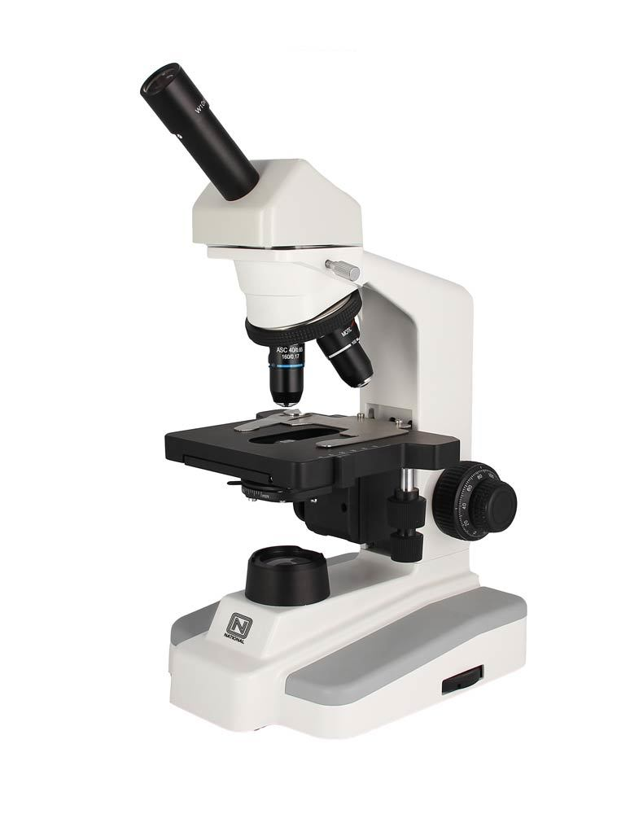

LEAD Others – Interpersonal Excellence (Leading Others)
How Great Leaders Create and Share an Inspiring and Positive Vision
In order to rally people to follow you, you must be able to articulate and communicate your vision in a simple, clear, bold, and compelling way.
1. A North Star
The vision a positive leader creates and shares serves as a North Star that points and moves everyone in an organization in the right direction. The leader must continually point to this North Star and remind everyone that this is where we are going.
2. A Telescope and a microscope
The telescope helps you and your team keep your eyes on your vision, North Star, and big picture. The microscope helps you zoom-focus on the things you must do in the short term to realize the vision in your telescope
Notes:
Need to check review these.

Slide 7
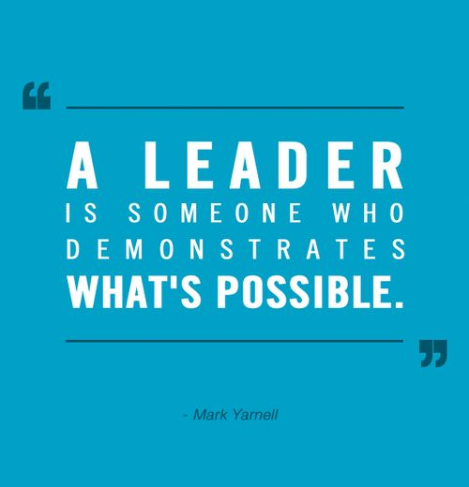
LEAD Others – Interpersonal Excellence (Leading Others)
Watch video: Bonnie Hagemann: Leading With Vision
https://www.youtube.com/watch?v=Ommeu3dBaac
Notes:
Need to check review these.

Slide 8
LEAD Others – Interpersonal Excellence (Leading Others)
How A To Speak Like Visionary
Focus on the present
Communicate Clearly
Let your audience experience the vision
Watch Ted Talk https://www.youtube.com/watch?v=o25c5wRvPnI
Notes:
Need to check review these.

Slide 9

LEAD Others – Interpersonal Excellence (Leading Others)
MANAGING CHANGE
Change is a common thread that runs through all businesses regardless of size, industry and age. Our world is changing fast and organizations must change quickly, too. Organizations that handle change well thrive, whilst those that do not may struggle to survive.
Notes:
Need to check review these.

Slide 10
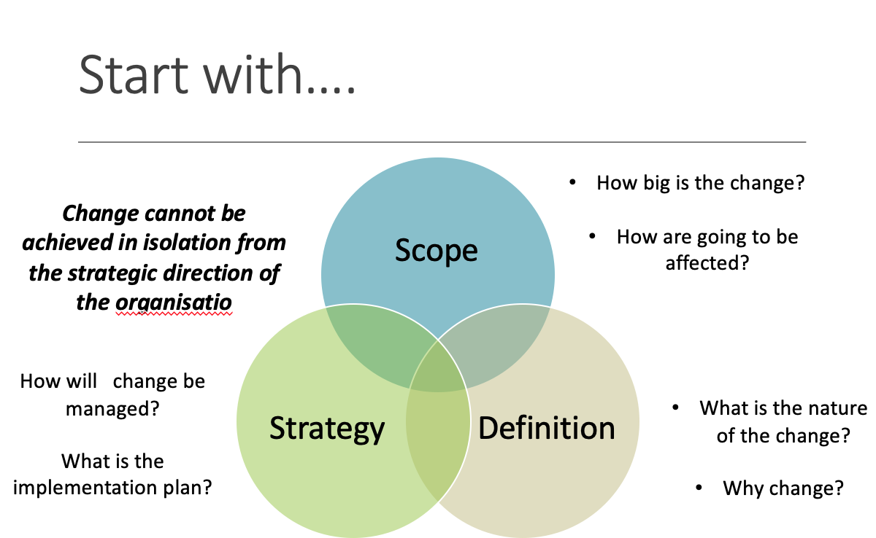
LEAD Others – Interpersonal Excellence (Leading Others)
MANAGING CHANGE
Notes:
Need to check review these.

Slide 11
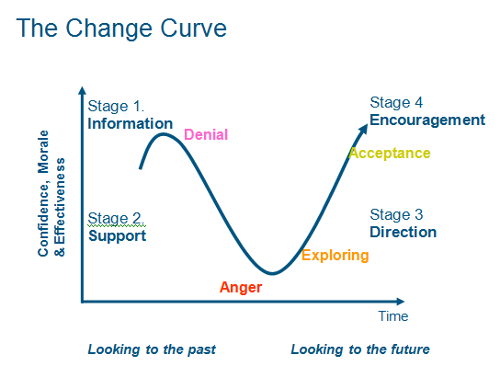
LEAD Others – Interpersonal Excellence (Leading Others)
MANAGING CHANGE
Also refer to the Personal Transition to Curve Change
Notes:
Need to check review these.

Slide 12
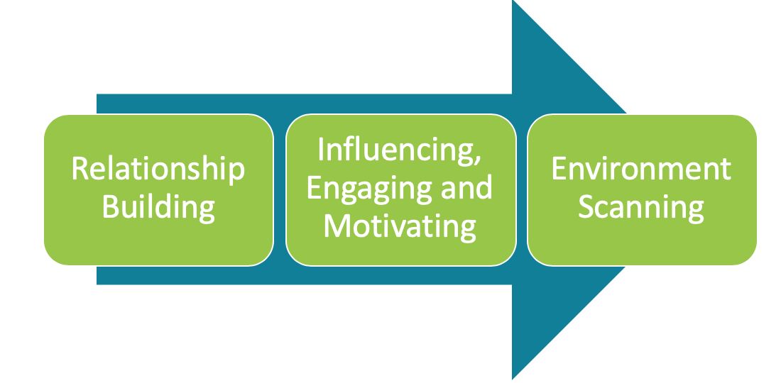
LEAD Others – Interpersonal Excellence (Leading Others)
CRITICAL SUCCESS FACTORS FOR MANAGING CHANGE
Notes:
Need to check review these.

Slide 13

LEAD Others – Interpersonal Excellence (Leading Others)
Do the Change Management Bite-Sized Training Session. This is designed to fit into just one hour, you will learn:
Why organizational change is so difficult.
What your personal tolerance for ambiguity is.
A model for understanding and communicating what change really is.
What you can do to effect change more smoothly.
To get started, just follow the steps below. And don't forget that we're here to help you by answering your questions in the Comments section.
Refer to your change management workbook
Source: MindTools
Notes:
Need to check review these.

Slide 14
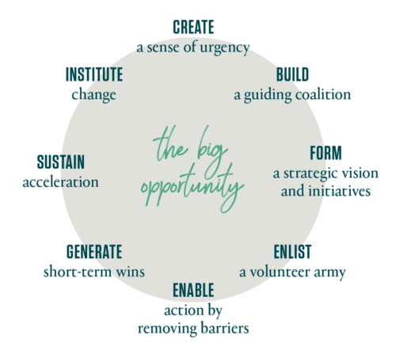
LEAD Others – Interpersonal Excellence (Leading Others)
8 Steps to Accelerate Change
Refer to the article by Kotter
Notes:
Need to check review these.

Slide 15
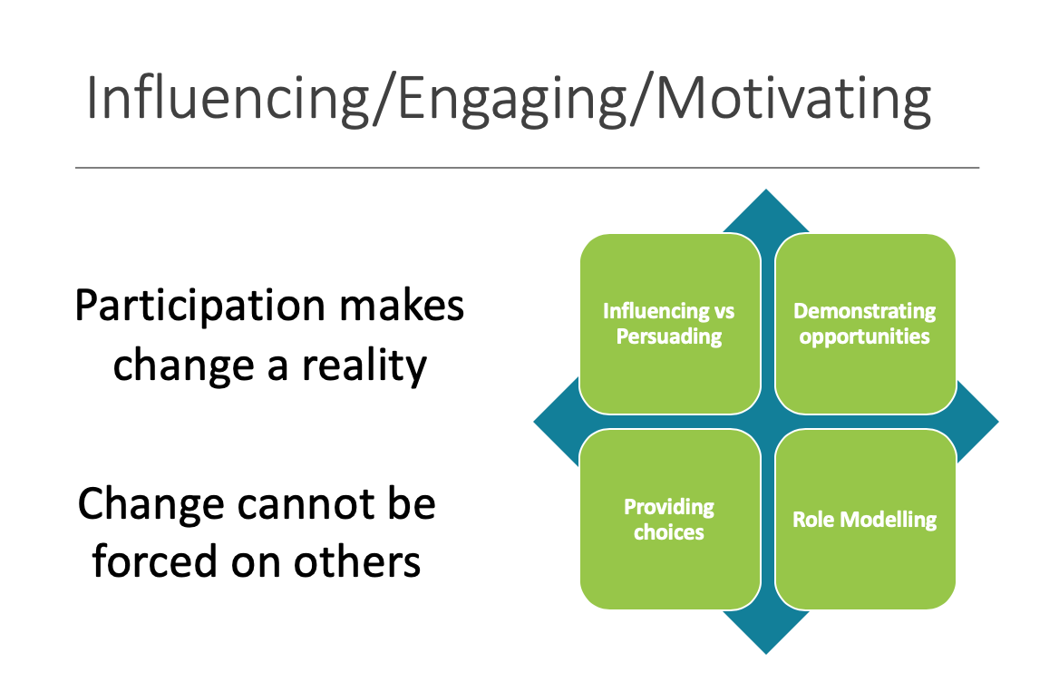
LEAD Others – Interpersonal Excellence (Leading Others)
Notes:
Need to check review these.

Slide 16
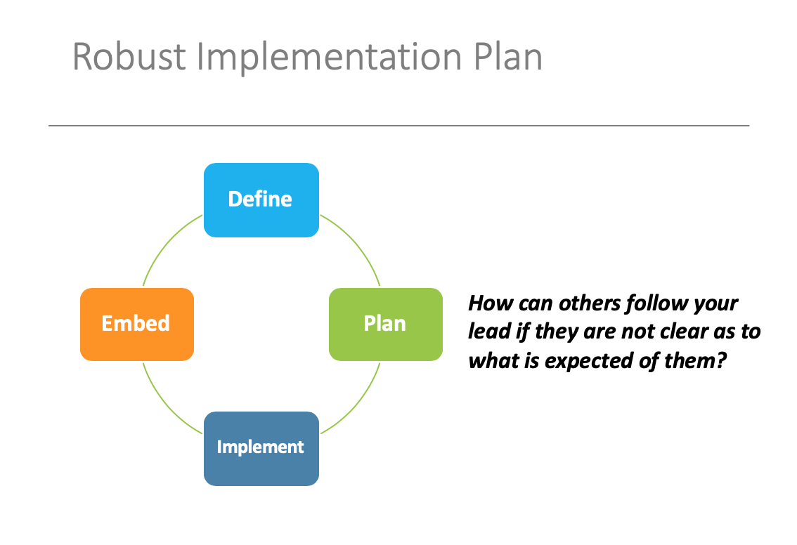
LEAD Others – Interpersonal Excellence (Leading Others)
Notes:
Need to check review these.

Slide 17
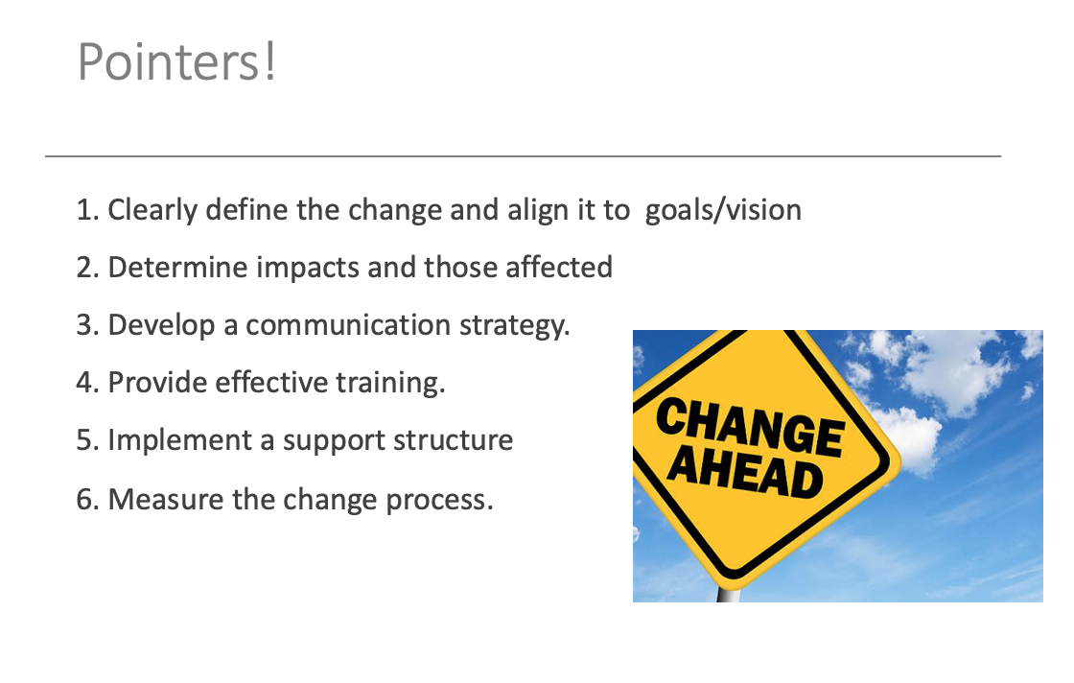
LEAD Others – Interpersonal Excellence (Leading Others)
Notes:
Need to check review these.

